Slide 1
王喻民(R07921009)、林柏宇(R07921070) Digital Control Systems 2019/6/14
Project Progress Report
Simulation Study of Cruise Control

Slide 2

References
[1: Molnár et al. 2018]
Tamás G. Molnár, Wubing B. Qin, Tamás Insperger, and Gábor Orosz, “Application of Predictor Feedback to Compensate Time Delays in Connected Cruise Control,” IEEE Transactions on Intelligent Transportation Systems, Vol. 19, No. 2, pp. 545-559, February 2018
[2: Zhang and Orosz 2016]
Linjun Zhang and Gábor Orosz, “Motif-Based Design for Connected Vehicle Systems in Presence of Heterogeneous Connectivity Structures and Time Delays,” IEEE Transactions on Intelligent Transportation Systems, Vol. 17, No. 6, pp. 1638-1651, June 2016
[3: Ploeg et al. 2014]
Jeroen Ploeg, Dipan P. Shukla, Nathan van de Wouw, and Henk Nijmeijer, “Controller Synthesis for String Stability of Vehicle Platoons,” IEEE Transactions on Intelligent Transportation Systems, Vol. 15, No. 2, pp. 854-865, April 2014
[4: Stépán 2001]
Gábor Stépán, “Vibrations of Machines Subjected to Digital Force Control,” International Journal of Solids and Structures, Vol. 38, No. 10-13, pp. 2149-2159, March 2001
[5: Qin and Orosz 2013]
Wubing B. Qin and Gábor Orosz, “Digital Effects and Delays in Connected Vehicles: Linear Stability and Simulations,” ASME 2013 Dynamic Systems and Control Conference, pp. V002T30A001, October 2013
Simulation Study of Cruise Control
王喻民、林柏宇

Slide 3
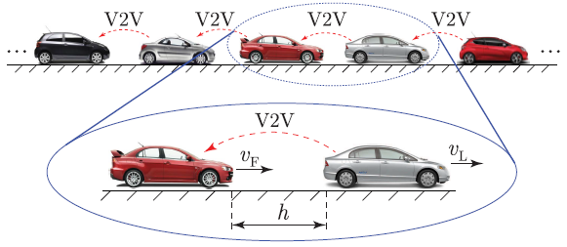
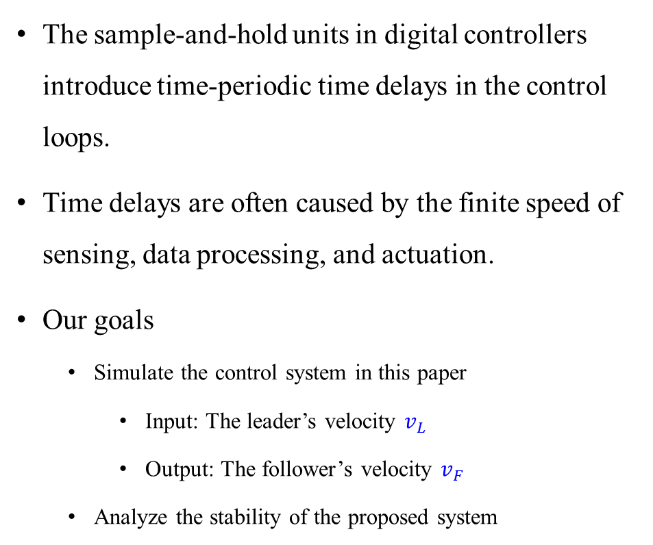
Introduction
The sample-and-hold units in digital controllers introduce time-periodic time delays in the control loops.
Time delays are often caused by the finite speed of sensing, data processing, and actuation.
Our goals
Simulate the control system in this paper
Input: The leader’s velocity $v_{L}$
Output: The follower’s velocity $v_{F}$
Analyze the stability of the proposed system
[1: Molnár et al. 2018]
Simulation Study of Cruise Control
王喻民、林柏宇

Slide 4
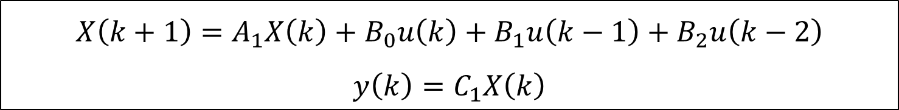
State Space Model
The state space model of the digital control system proposed in [1: Molnár et al. 2018].
The sampling period is 0.1(sec).
$$X\left(k+1\right)=A_{1}X\left(k\right)+B_{0}u\left(k\right)+B_{1}u\left(k−1\right)+B_{2}u\left(k−2\right)$$
$$y\left(k\right)=C_{1}X\left(k\right)$$
where $A_{1}=\left[\begin{matrix}a_{0} & a_{1} \\ I & 0\end{matrix}\right],B_{0}=\left[\begin{matrix}b_{0} \\ o\end{matrix}\right],B_{1}=\left[\begin{matrix}b_{1} \\ o\end{matrix}\right],B_{2}=\left[\begin{matrix}b_{2} \\ o\end{matrix}\right],C_{1}=\left[\begin{matrix}c & o^{T}\end{matrix}\right]$
Simulation Study of Cruise Control
王喻民、林柏宇

Slide 5
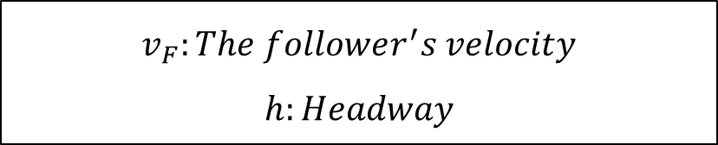
Preliminary Results
The step response of the digital control system
$$v_{F}:The follower^{′}s velocity$$
$$h:Headway$$
Simulation Study of Cruise Control
王喻民、林柏宇

Slide 6
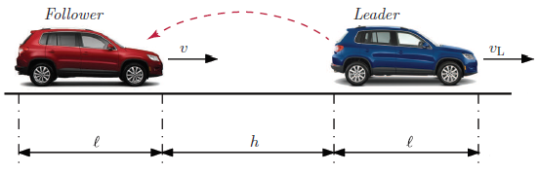
Future Works
Stability Analysis
Simulate the system with different sampling period.
Simulate the system with different control gain.
[5: Qin and Orosz 2013]
Simulation Study of Cruise Control
王喻民、林柏宇

